Slide 1
INFS 112:
Introduction to Information Management
Session 1 – Concepts of Information
Lecturer: Dr. Perpetua S. Dadzie, Dept. of Information Studies
Contact Information: psdadzie@ug.edu.gh

Slide 2
Session Overview
At the end of the session, the student will be able to:
Define and differentiate among data, information and knowledge
Explain how and why data, information and knowledge are essential in our daily lives
Understand the knowledge pyramid

Slide 3
Session Outline
The key topics to be covered in the session are as follows:
Topic One - What is data?
Topic Two - What is information?
Topic Three – What is knowledge?
Topic Four – Knowledge Pyramid

Slide 4
Reading List
Elearn (2009). Information and Knowledge Management. Revised Edition. Burlington, MA: Elsevier Ltd. pp. 2-6 (e-book)
Debons, A. (2008). Information Science 101. Lanham, Maryland: The Scarecrow Press Inc. pp. 3-7
Palmer, S. & Weaver, M. (1998). Information Management. Oxford: Butterworth Heinemann. pp 22-26

Slide 5
Introduction
In the field of Information science it is very necessary to distinguish among 3 core components of the discipline;
    Data
    Information
    Knowledge

Slide 6
What is data?
Topic One

Slide 7
What is Data?
Most people ignorantly use the term data synonymously with information but technically speaking this is not accurate.
Data is the building block of information and knowledge
It serves as the resource from which information is generated
It does not have meaning of itself
It can exist in any form, usable or not.

Slide 8
What is Data?
Data are raw facts and figures that on their own have no meaning. These can be any alphanumeric characters i.e. text, numbers, symbols. For example: 12A4GH7; 17, 25,
Data simply exists and has no significance beyond its existence (in and of itself).
Data is comprised of the basic, unrefined, and generally unfiltered information
Data must be organized to become information.

Slide 9
What is Data?
Data Examples
Yes, Yes, No, Yes, No, Yes, No, Yes
42, 63, 96, 74, 56, 86
111192, 111234
GH¢80, GH¢102, GH¢200, GH¢150
Can you interpret the meaning of the above?
None of the above data sets have any meaning until they are given a CONTEXT and PROCESSED into a useable form

Slide 10
What is Data?
Purpose of Data
to record activities or situations, to attempt to capture the true picture or real event. Therefore, all data are historical, unless used for illustration purposes, such as forecasting.

Slide 11
What is information?
Topic Two

Slide 12

What is Information?
Is this information:
  Treuliodd y rhif cwsmer ١٨ bron i dri chant o ddoleri mewn un pryniant - gwerthiant mwyaf y mis diwethaf!
  - Why yes/no?
Is this information:
  This is a regular patron who borrows at least six books at a time and has never missed a deadline in returning his books.
  - Why yes/no?

Slide 13
What is Information
Information
collection of facts organized in such a way that they have additional value beyond the value of the facts themselves
Data that has been processed within a context to give it meaning
Data that has been processed into a form that gives it meaning
A subset of data, only including those data that possess context, relevance and purpose
Manipulation of raw data
Data that are processed to be useful; provides answers to "who", "what", "where", and "when" questions

Slide 14
What is Information
The definition of Information can be summarized as an aggregation, organization or classification of data and meaning that is assigned to data (Rubin, 2004)

Slide 15
What is Information
Information by itself is only of use if it is:
the right information (fit for the purpose)
at the right time
in the right format
at the right price

Slide 16
What is Information
Purpose of Information
To understand what the organization as a whole is doing as well as understand what is happening in your own unit or department
To be aware of the wider industry developments that may impact on your library or archives set up
To solve day-to-day problems and to help with long-term planning
To help avoid reinventing the wheel
To be aware of different practices which are bringing new ideas and facilitating change

Slide 17
What is knowledge?
Topic Three

Slide 18
What is Knowledge?
Knowledge is
appropriate collection of information, such that its intent is to be useful.
understanding of rules needed to interpret information
application of data and information; answers "how" questions
a mix of contextual information, experiences, rules, and values.

Slide 19
What is Knowledge?
Note : Tremendous amount of information that is generated is only useful if it can be applied to create knowledge within the organisation.
Two types of knowledge
Tacit/hidden knowledge - Within the organisation there are certain people who hold specific knowledge or have the 'know how‘

Slide 20
What is Knowledge?
Tacit …
For ex. -- "I did something very similar to that last year and this happened…..
Tacit knowledge "is personal, context-specific and hard to formalize and communicate.
A [knowledge] developed and internalized by the knower over a long period of time . . .

Slide 21
What is Knowledge?
Tacit ….
incorporates so much accrued and embedded learning that its rules may be impossible to separate from how an individual acts. ‘knowing how’ Eg. The knowledge that you use when driving a car

Slide 22
What is Knowledge?
Explicit/formal
knowledge that can be easily collected, organized and transferred through digital means.
  A theory of the world, conceived of as a set of all of the conceptual entities describing classes of objects, relationships, processes, and behavioral norms. Often referred to as ‘knowing that’, or declarative knowledge. Eg. the knowledge available from a driving manual or the Highway Code

Slide 23
What is Knowledge?
Explicit/formal …
This is knowledge that has been captured and used to develop policies and operating procedures for example.

Slide 24
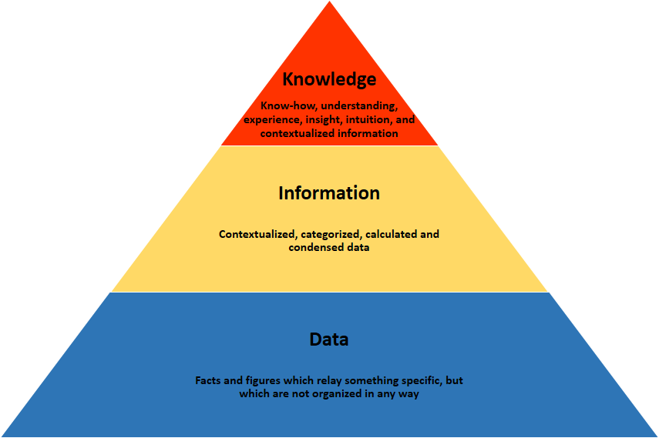
The Knowledge Pyramid

Slide 25
Video
What is the difference between data, information and knowledge?
<iframe width="560" height="315" src="https://www.youtube.com/embed/mUgEgkV16Bw" frameborder="0" allowfullscreen></iframe>

Slide 26
Activity
Using the Knowledge pyramid as a guide, list five items of data, information and knowledge.
Summarize what you use each item for – your purpose
Note how you add value to each item to create information or knowledge
Who is involved in this process?

